Slide 1
Presentation on :
Twitter Sentiment Analysis

Slide 2
Presented by:
Nouman Rasool
BSIT
023R15-25

Slide 3
Presentation Outline
Introduction
Objectives
Technology Platform Overview
Implementation
Screenshot
Evaluation
Conclusion

Slide 4
Introduction
Sentiment Analysis
Application perform
Collect Tweets
Analyze tweet
Stats Results

Slide 5
Objective
The objective of my system is :
Compare tweets in efficient and compact manner
Fast response of every activity
Facilitate easy data entry
To implement an algorithm for automatic classification of negative and positive tweets.
Analyze the public sentiment with respect to time
To develop functional classifier for accurate and automatic sentiment classification of tweets like negative, positive.

Slide 6
Technology Platform overview
Windows
Python platform
Twitter API
Sublime, Vscode, jupyter
SQLITE3

Slide 7
Implementation
Twitter API used for getting tweets from twitter
The project working by using NAÏVE BAYES algorithm for classification of tweets and Twitter API used for collect the tweets
Libraries:
Tweepy for getting tweets
Tkinter for GUI
Textblob for processing textual data
Matplotlib for plotting graph
SQLITE for DB

Slide 8
Methodology
NAIVE BAYES algorithm used in this project:
classification technique based on Bayes’ Theorem
Naive Bayes classifier assumes that the presence of a particular feature in a class is unrelated to the presence of any other feature
My system is based on Rapid application development (RAD) model because I have all information about my project and no need of going backward during Process

Slide 9
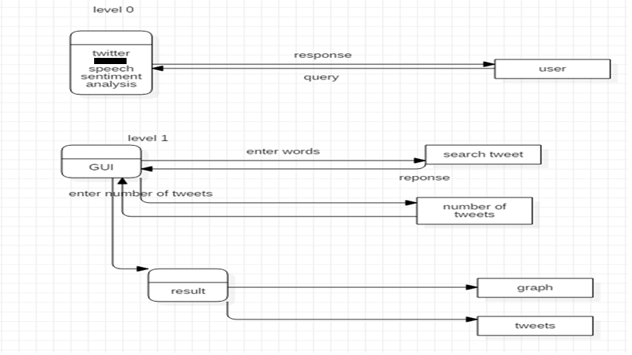
DFD

Slide 10
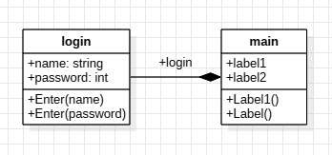
Class Diagram

Slide 11
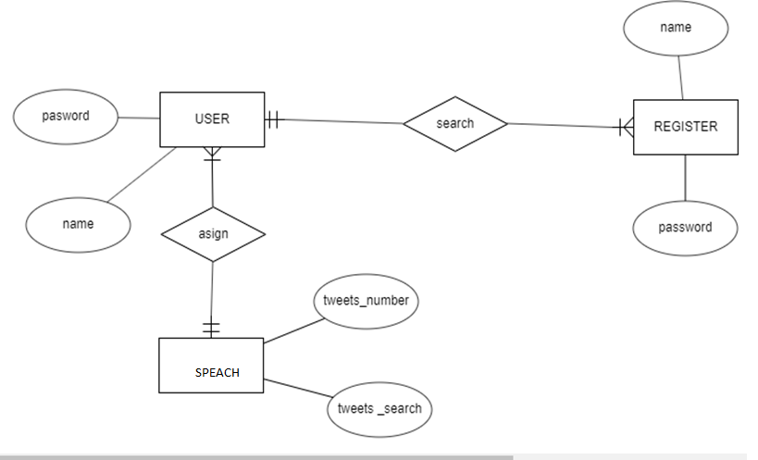
ERD

Slide 12
Software snapshot demo
This chapter highlights the result of the project and the snapshots for each of the activities are shown along with the discussion of each activity describing its working. Each
Snapshot describe every single step of the application

Slide 13
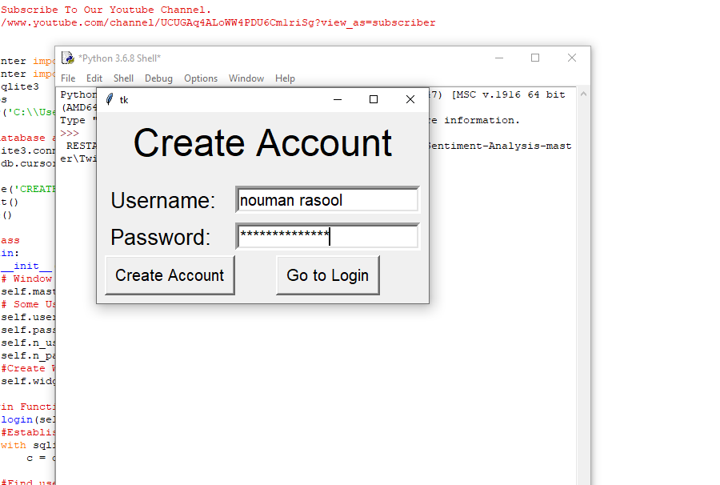
Snapshot

Slide 14
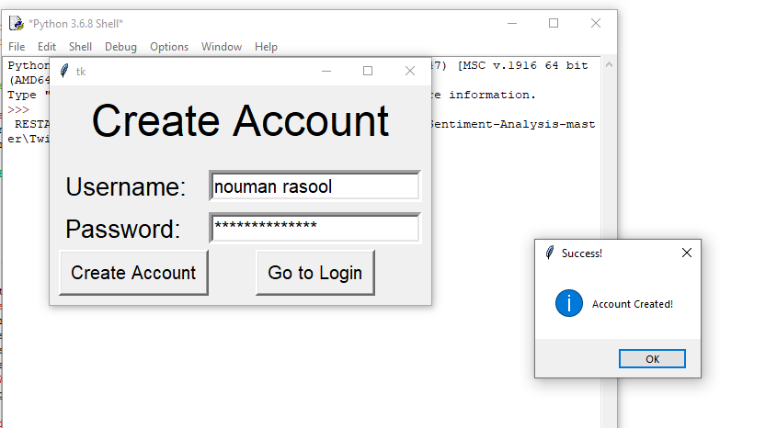
Snapshot(Continued)

Slide 15
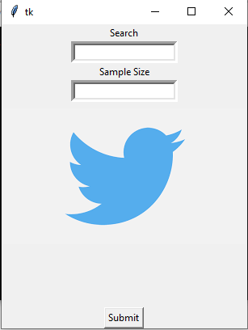
Snapshot(Continued)

Slide 16
Evaluation

Slide 17
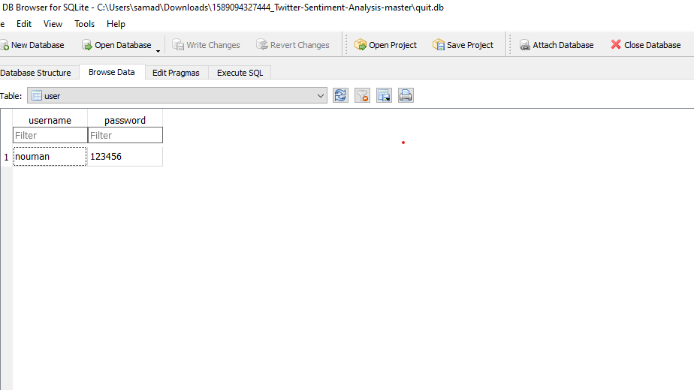
Evaluation(Continued)

Slide 18
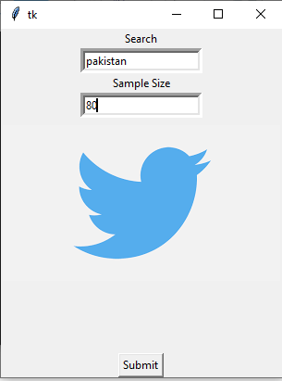
Evaluation(Continued)

Slide 19
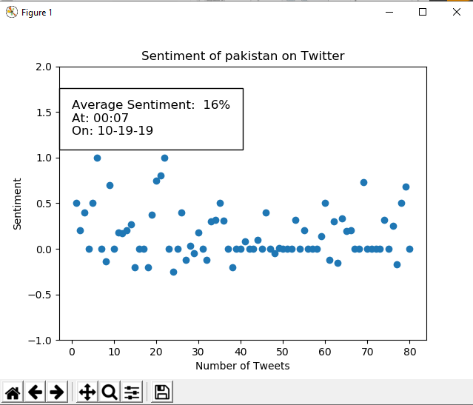

Slide 20
Conclusion
I have completed my project by using python language.
Thus the basic knowledge required to do sentiment analysis of Twitter is well stated in this review paper.
What is Sentiment Analysis with respect to levels of sentiment analysis, what are the approaches to do sentiment analysis, methodologies for sentiment analysis, features to be extracted from text and the applications where it can be utilized is mentioned hierarchically.
If we want to do Twitter’s sentiment analysis we need to know about the twitter, about extracting the tweets, its structure, their meaning. This paper gives brief notion of tweets.
When one wants to do sentiment analysis of tweets, he has to do it in a specialized aspect of sentiment analysis.
So the brief knowledge about Twitter Sentiment Analysis is given in this paper

